Slide 1
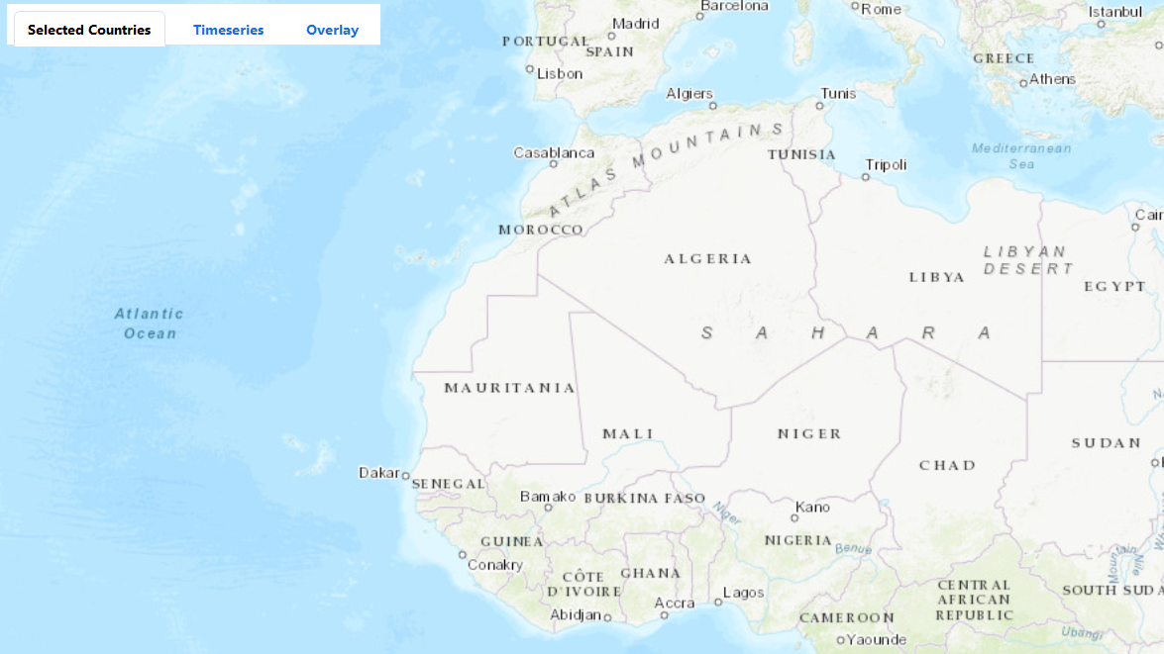

Switch tabs for different utilities
Move and zoom as desired

Slide 2
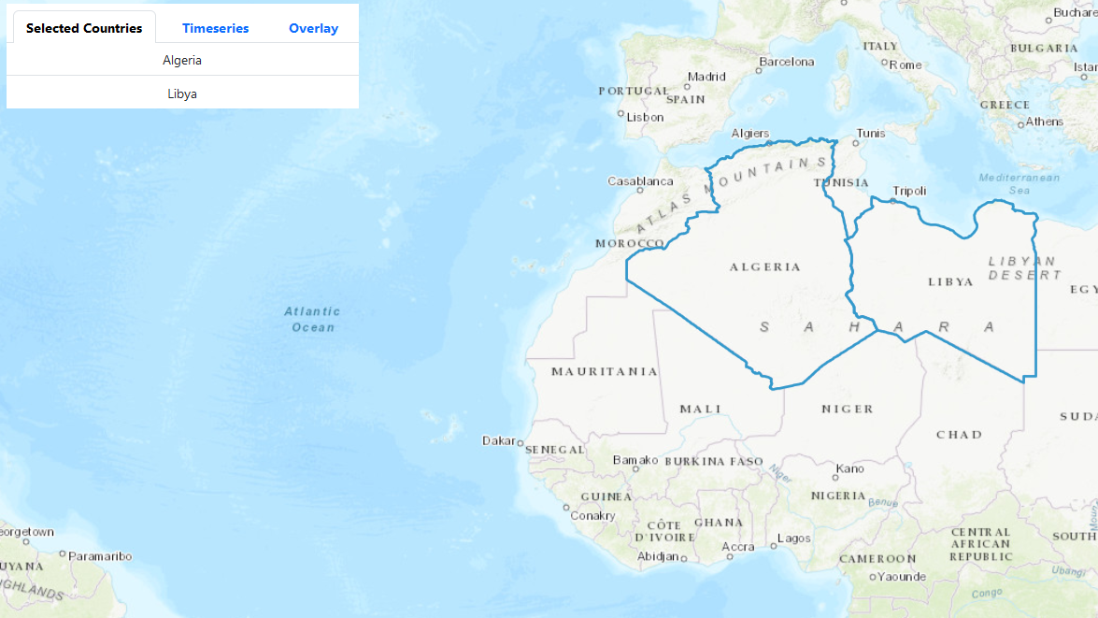
Current Selection will be show here
Click on countries to select

Slide 3
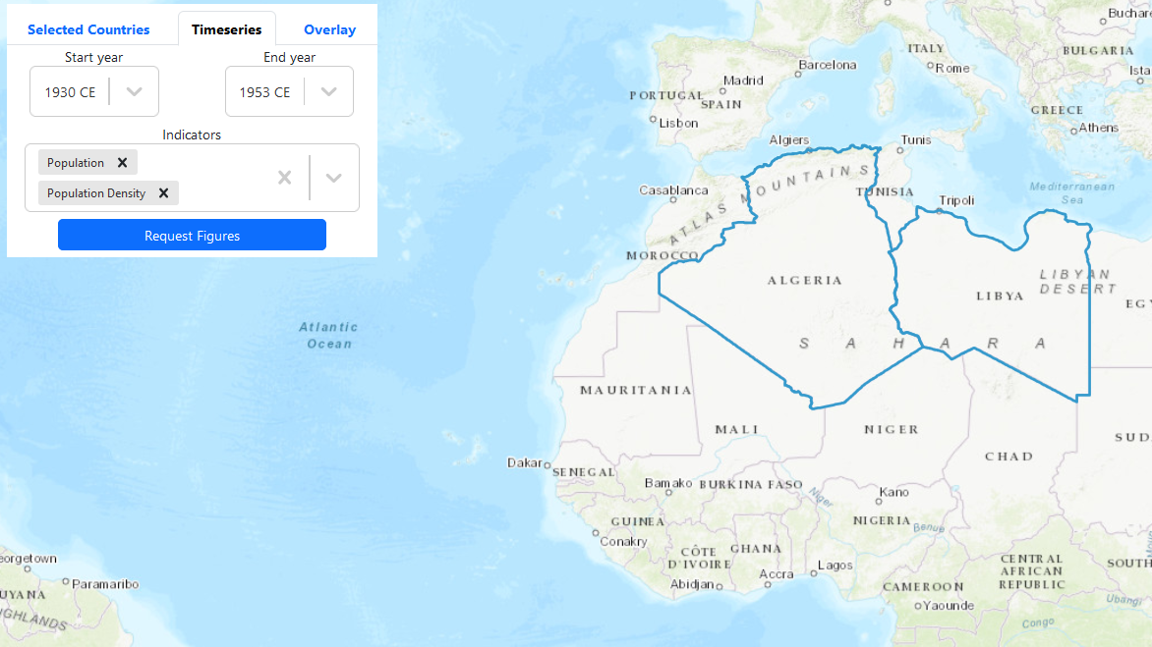
For selected countries,
select starting and end year
and desired indicators
Request Graphs
Location of requested graph

Slide 4
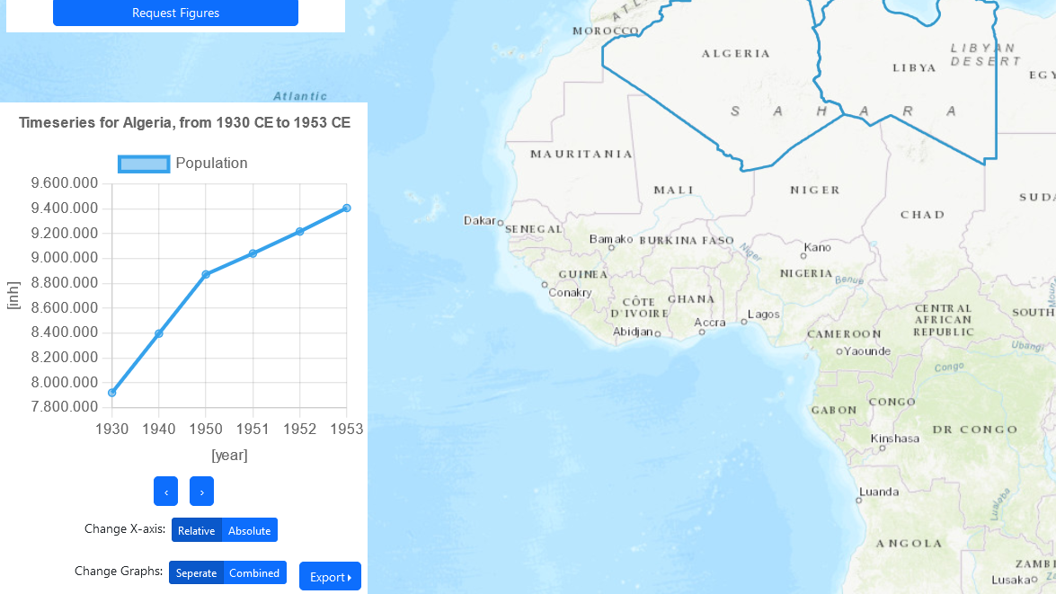
Example graph
Hover nodes to see values
Change Graphs,
Change plotting options
Allow different export options

Slide 5
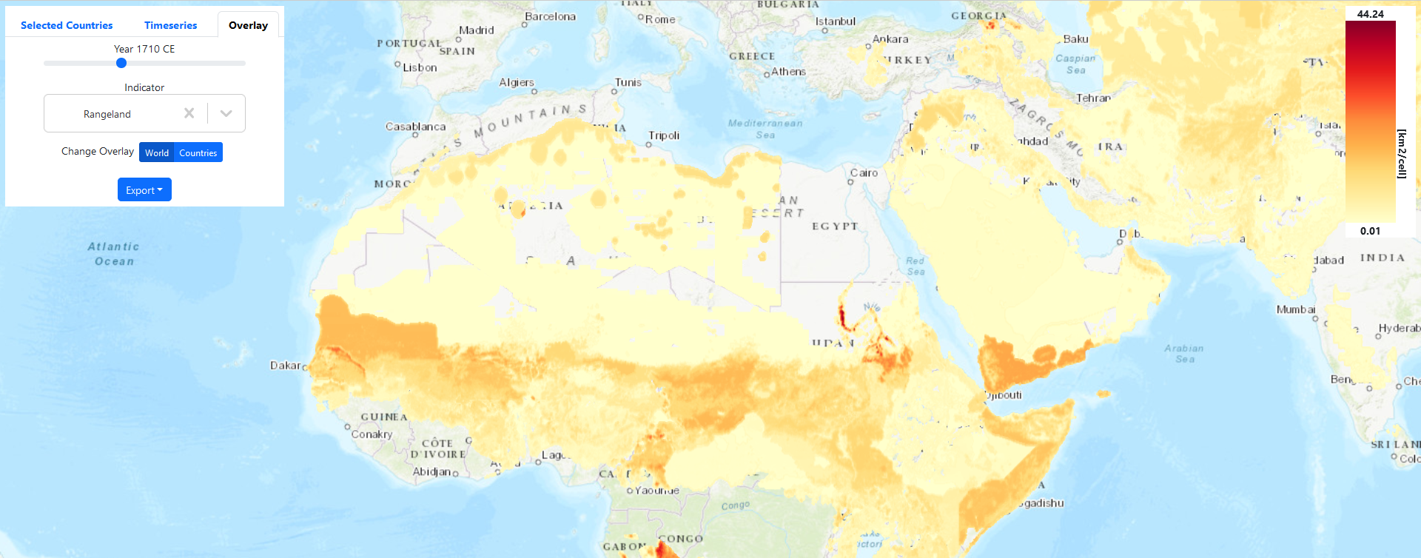
Select year and indicator
Legend showing
units and range of
values
Switch world and country rasters
Export data

